Slide 1
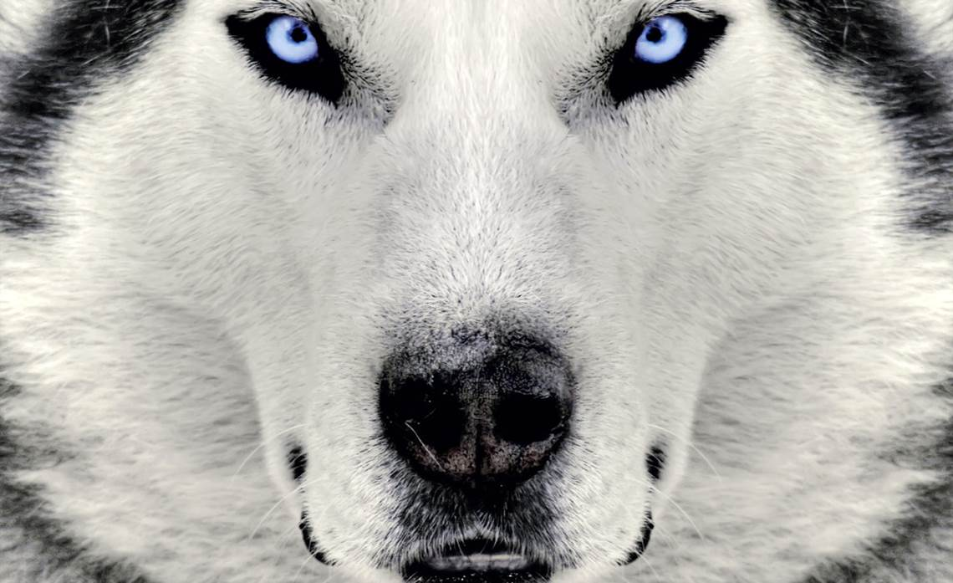
2016 Iditarod Race

Slide 2
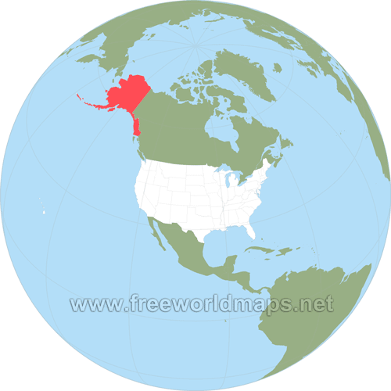
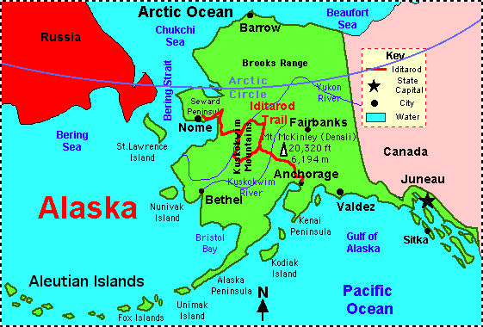
What is the Iditarod Race?
The Iditarod is a dog sled race from Anchorage, Alaska to Nome, Alaska.

Slide 3
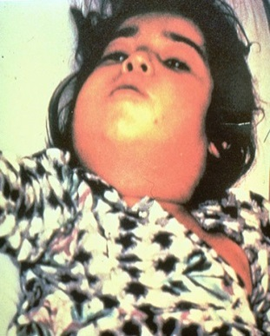
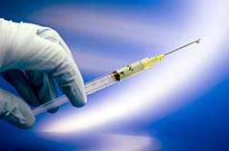
History
In 1925 diphtheria spread throughout the city of Nome. There is a vaccine for diphtheria but because of the harsh weather in Alaska it couldn’t be delivered. Airplanes were not yet reliable transportation in Alaskan weather. A rescue relay of mushers pulled by trained teams of sled dogs delivered the vaccine and stopped the spread of the deadly disease. This race is to commemorate the mushers and their dogs who raced against time to help the people of Nome.

Slide 4
Two Routes
There are two routes that are used for this race, a north and a south route.
Click here to see
which route they
will take this year.

Slide 5
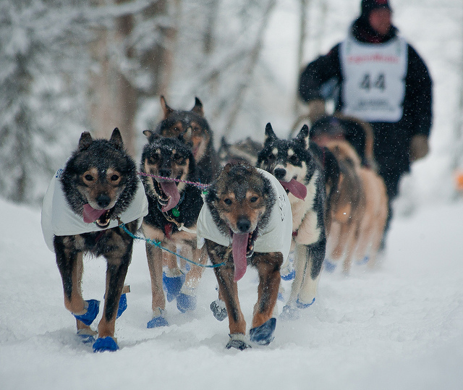
Task
You will look over the mushers that are on the Iditarod website. You will choose one veteran and one rookie musher to follow. You will use the website to gather information on your two mushers. Use the sheet your teacher gave you to record your research.

Slide 6
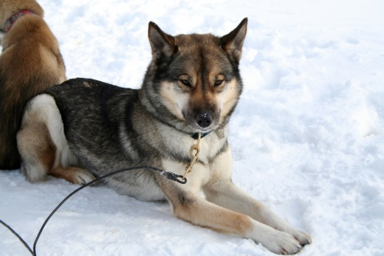
Following Your Mushers
You will follow your mushers progress using the Iditarod website. Don’t be bothered if your musher does not progress on a certain day. During the race they will be required to take a 24 hour rest and an 8 hour rest.
When the race is over you will fill in the rest of the information on your sheet.

